Slide 1
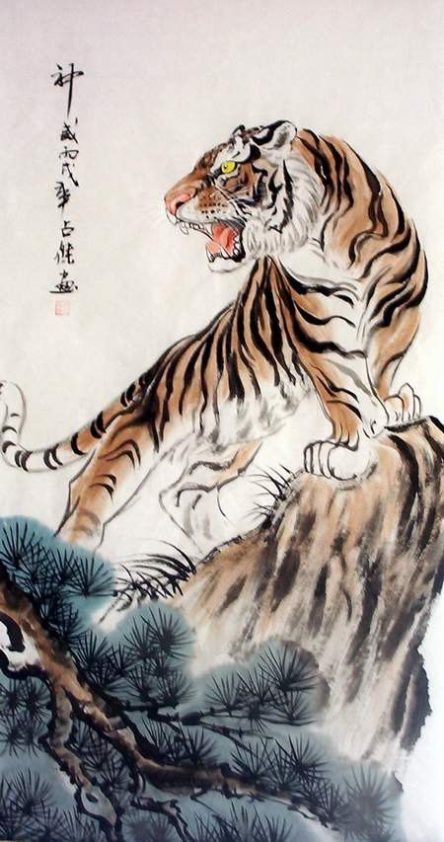
The Jungle Game
Chesshire Coders
Angélica Fallas
Taner King
Adam Gundem
Alexander Hennings
Cameron Ackerman
Image from: http://www.tattoodaze.com/tattoo-images/79/th_tiger-art-decor-mountain-tiger-tiger-hand-painting-original-bkLbwV.jpg

Slide 2
Table of contents
Changes from last iteration
Sequence diagrams
Class diagram
System test cases
JUnit test cases.
Project Tools & Progress
Demo

Slide 3
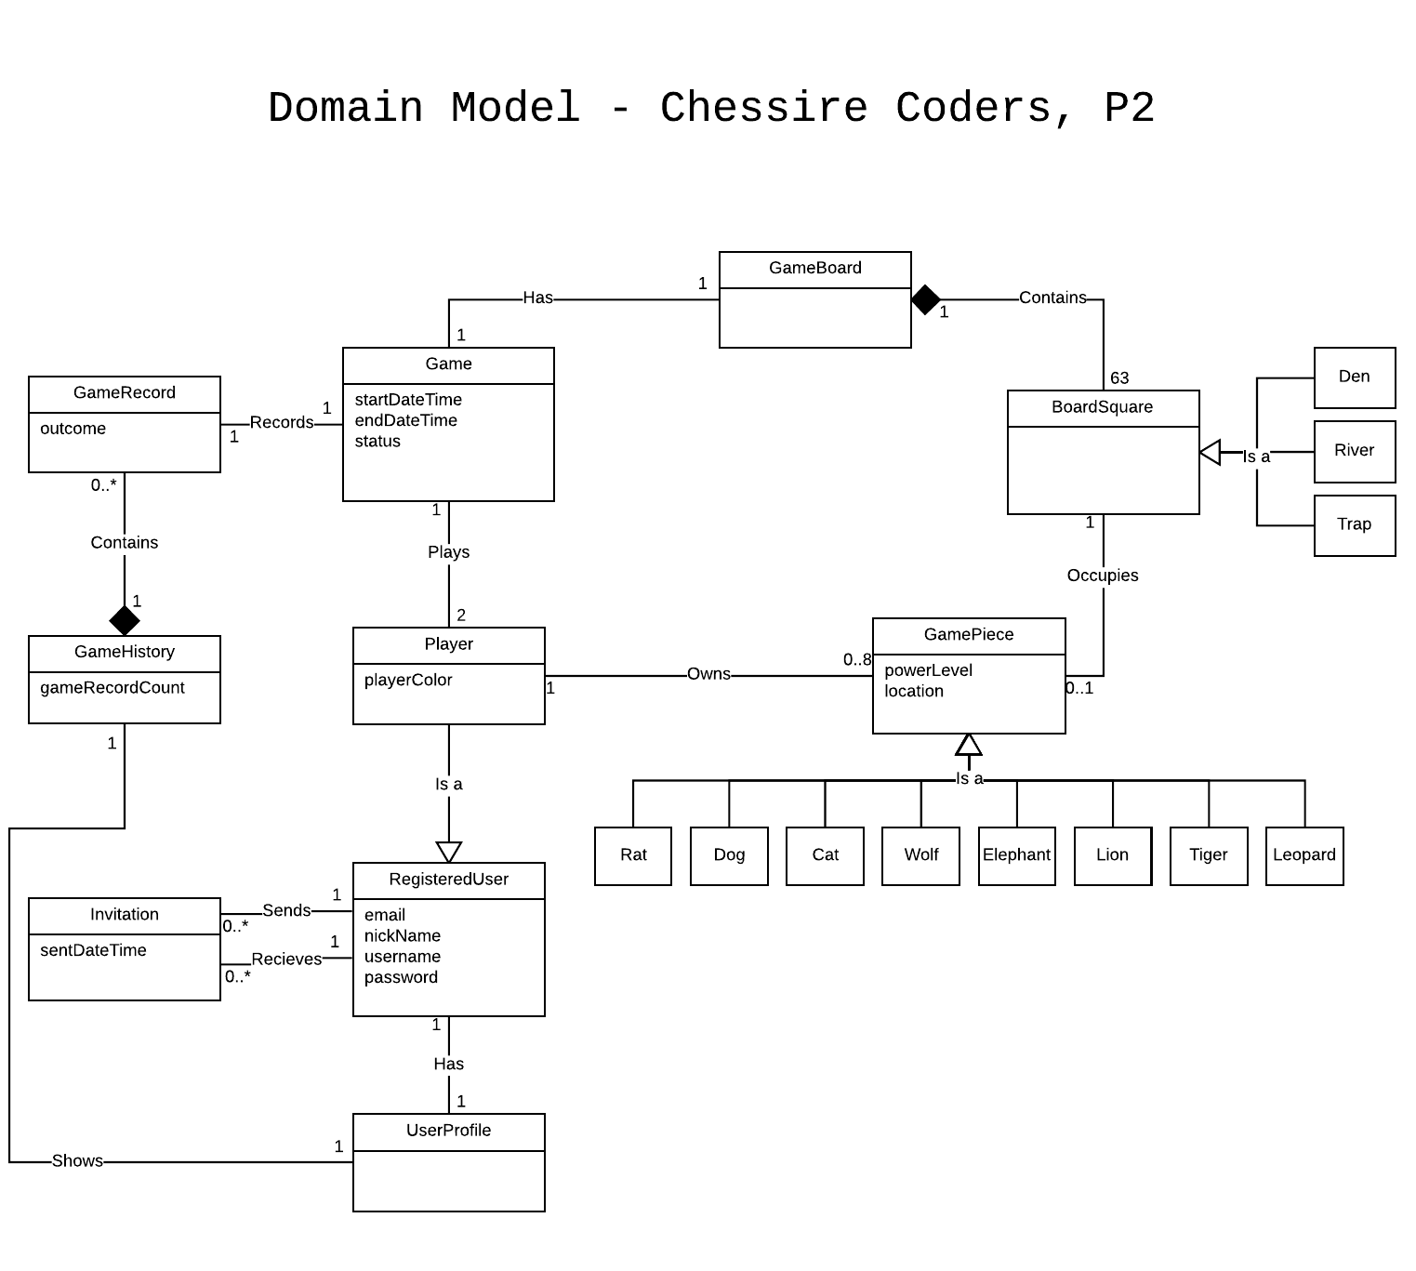
Domain Model Changes
Removed piece from BoardSquare and players from Game.
To keep notation consistent (association vs attribute vs both).

Slide 4
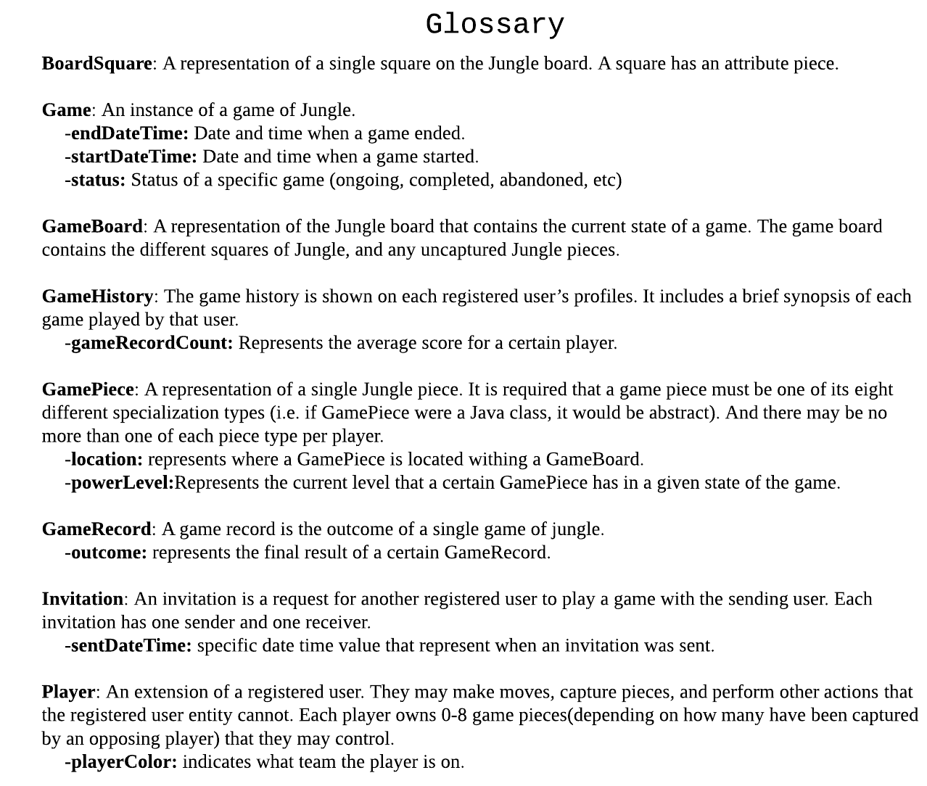
Glossary Changes
Added entries for attributes.
Sorted items alphabetically.

Slide 5
Sequence diagrams
Login
Game Invite
Game Create
Register
Take Turn

Slide 6
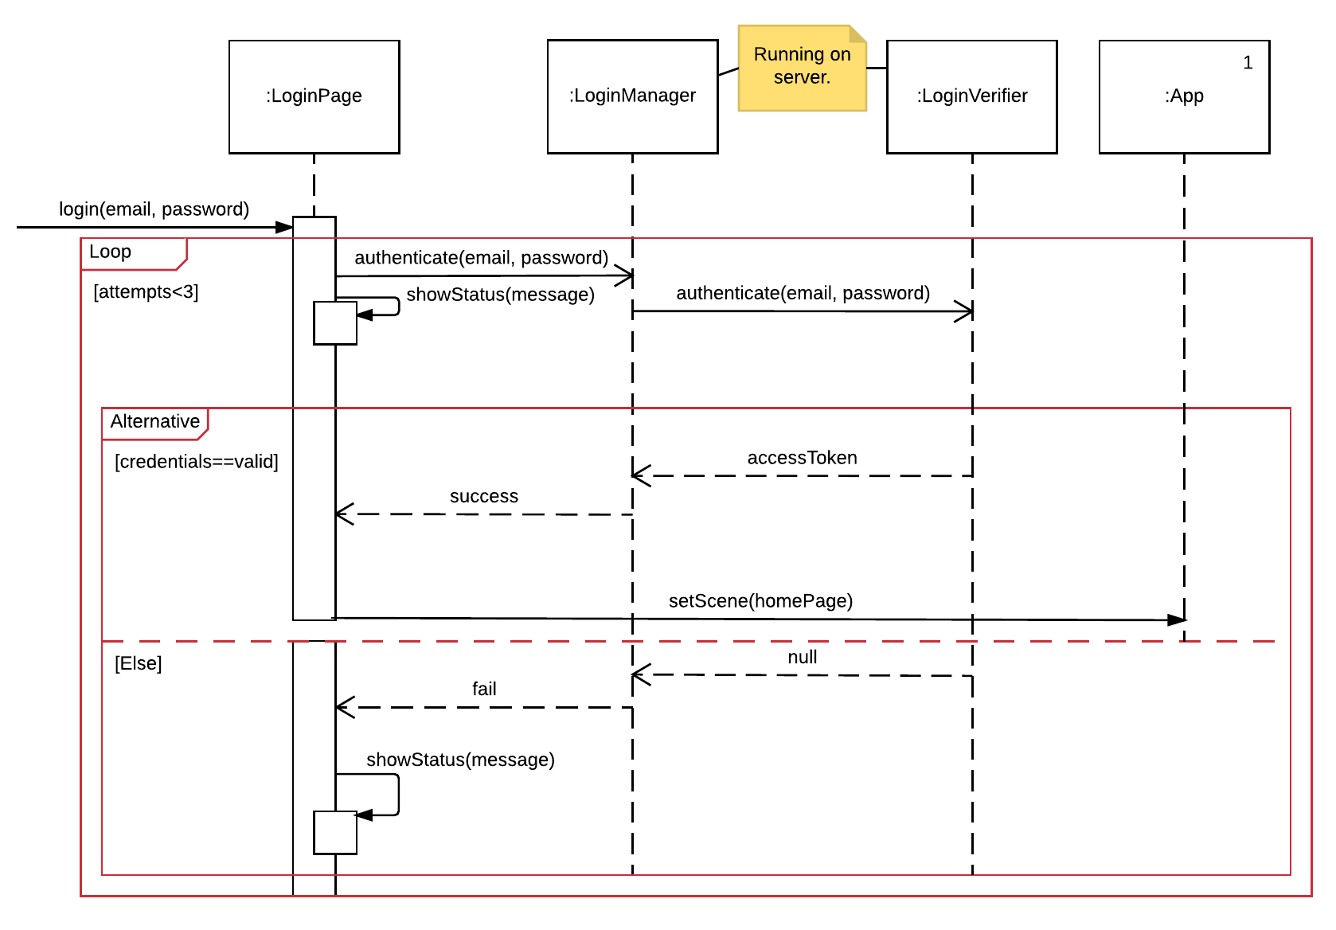
Login

Slide 7
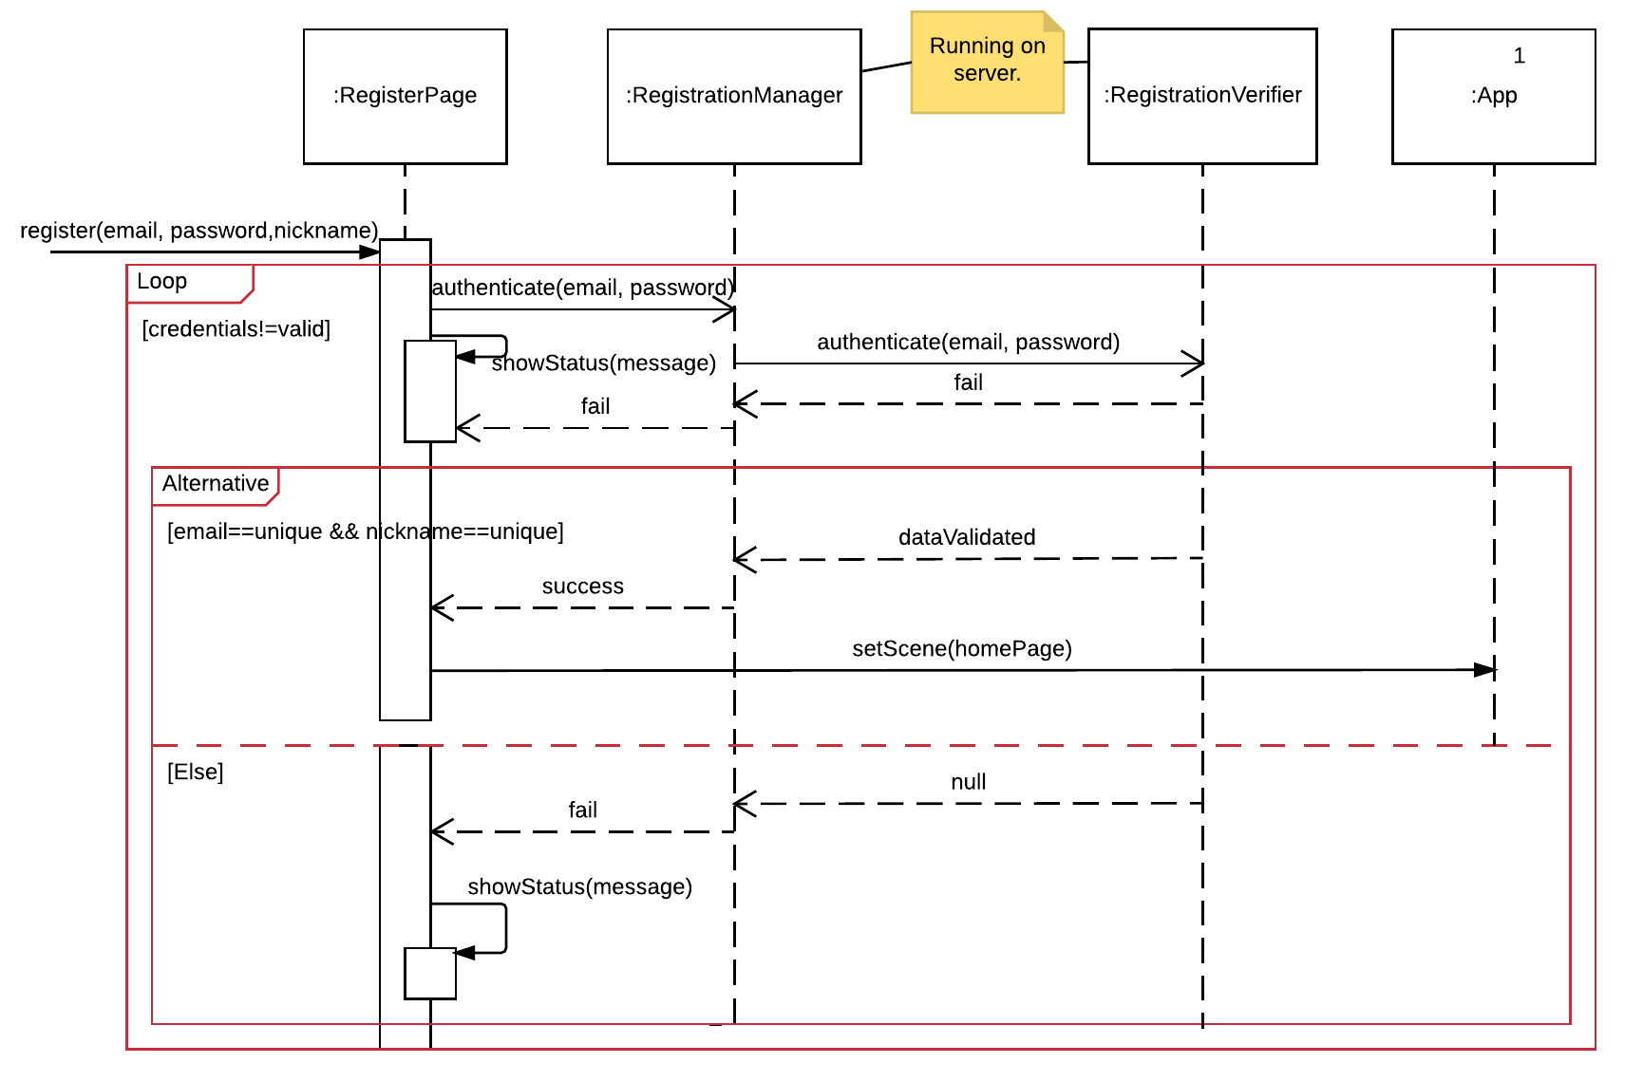
Register

Slide 8
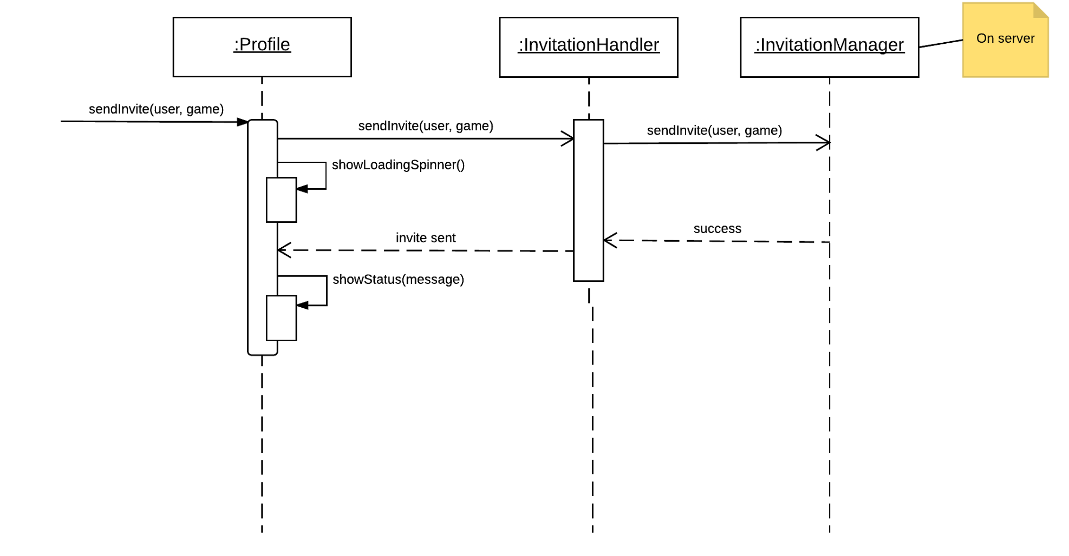
Game Invite

Slide 9
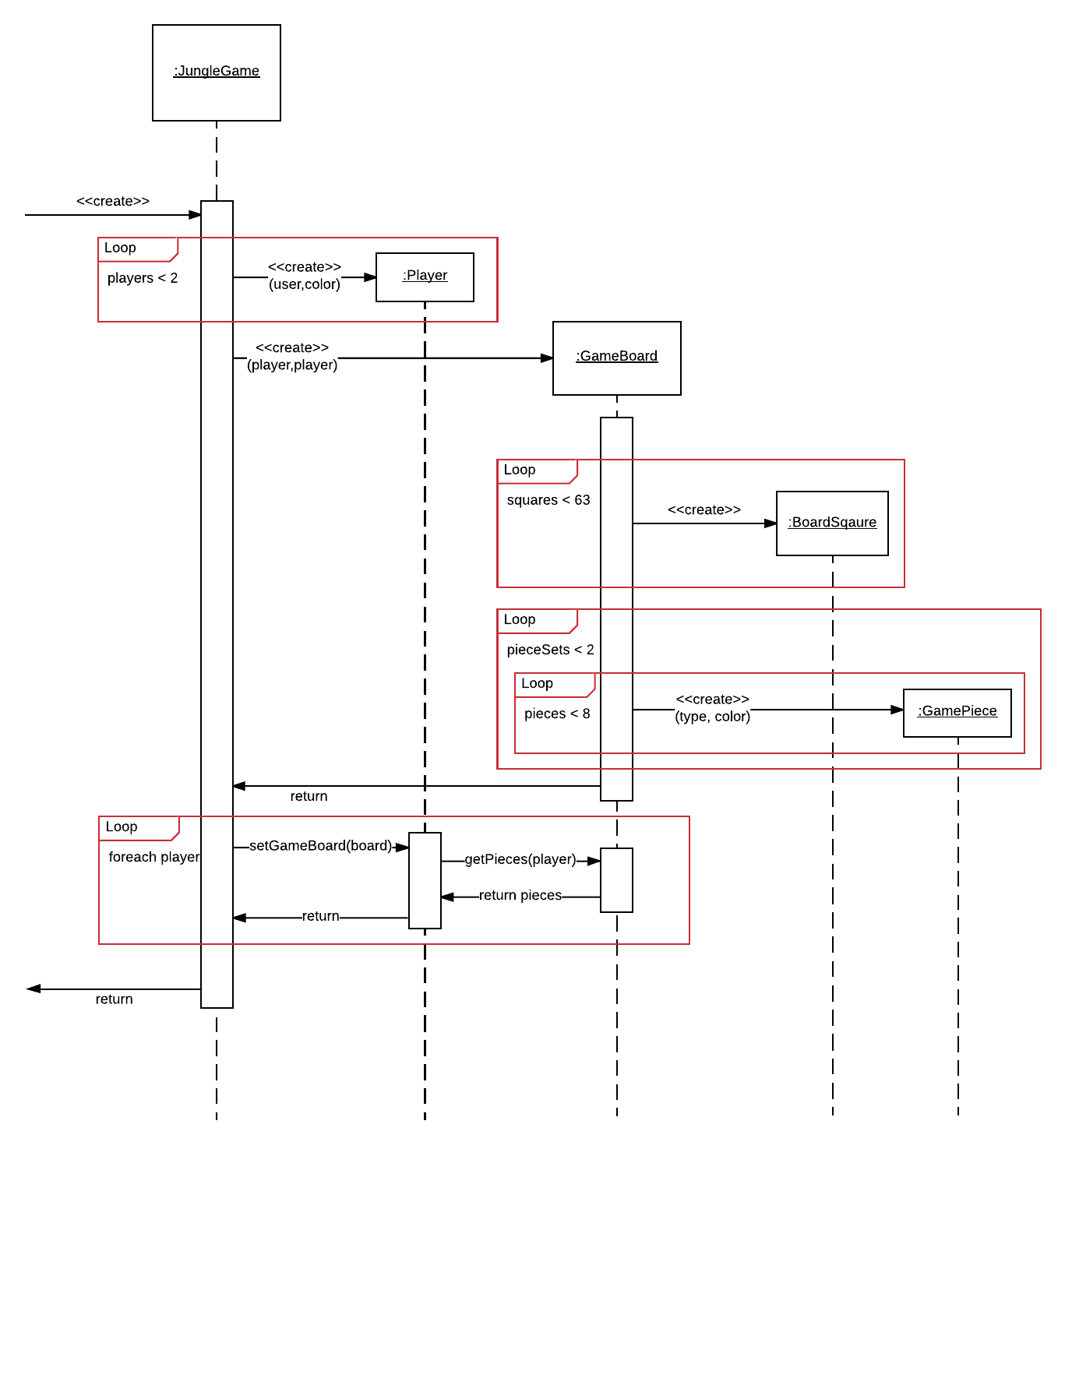
Create Game

Slide 10
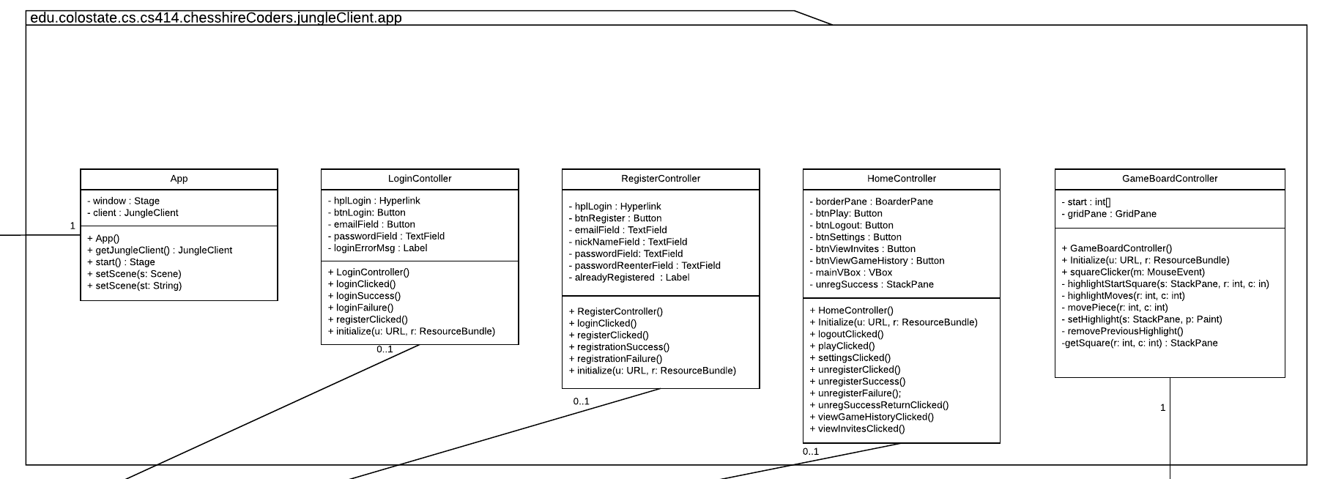
Class Diagram

Slide 11
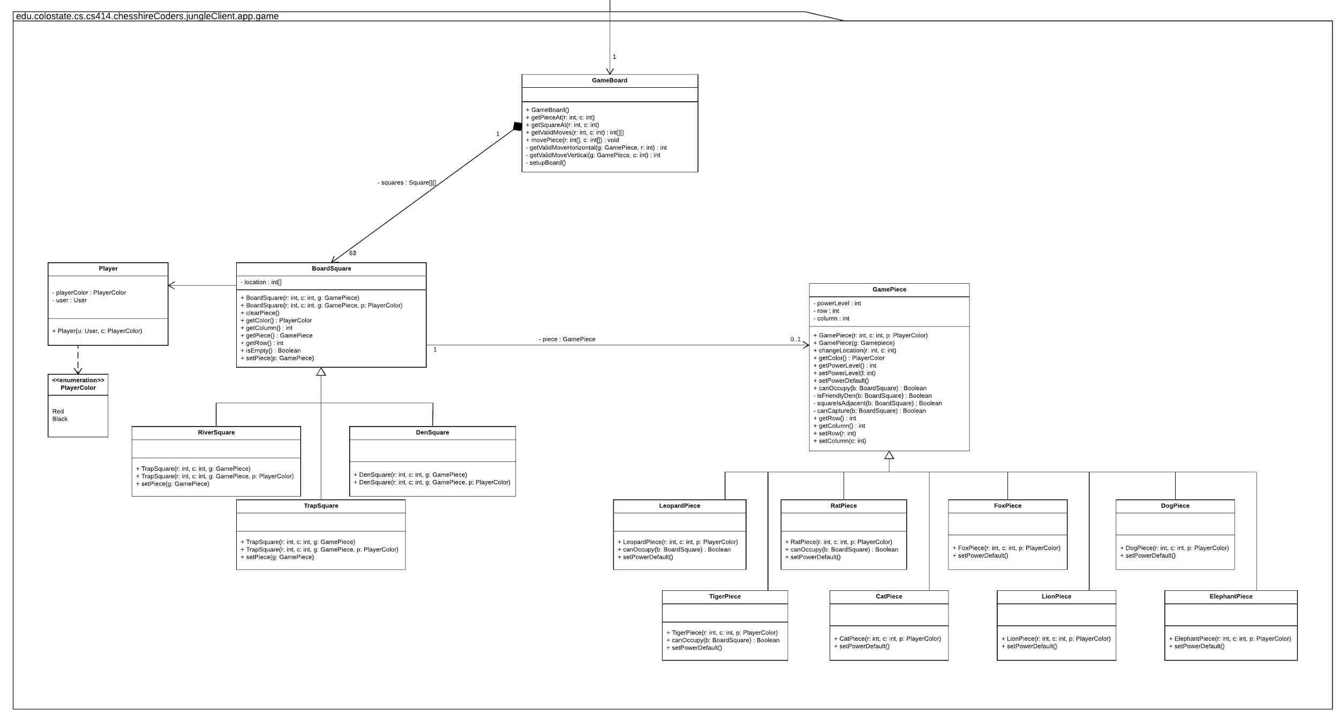
Class Diagram

Slide 12
Class Diagram cont.

Slide 13
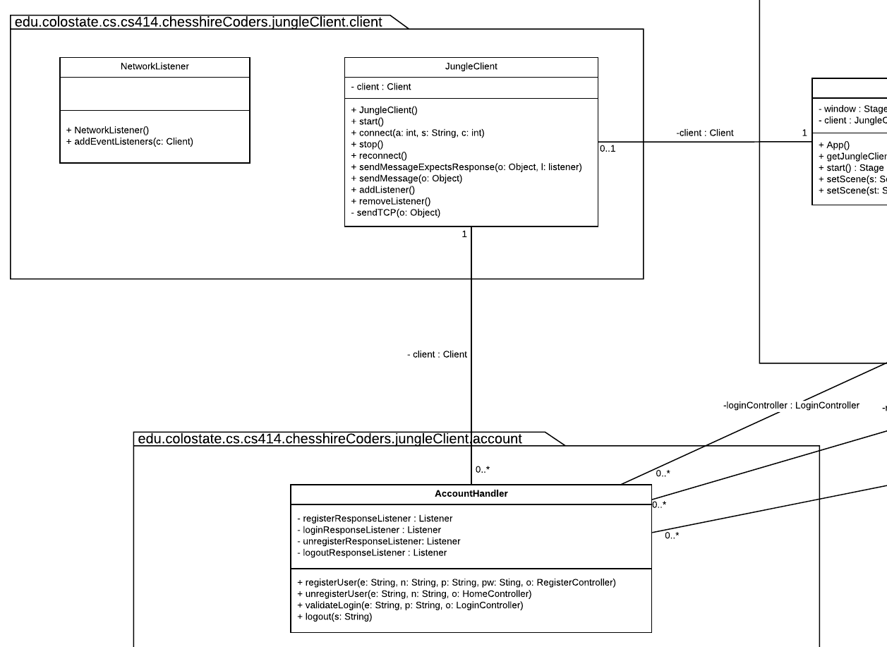
Class Diagram cont.

Slide 14
List of test cases:
TestAccountHandler
testRegisterUser
testRegisterUserAlreadyRegistered
testRegisterUserFailure
testUnregisterUser
testValidateLogin
testLogout
TestGameBoard:
testGetPieceAt_normal
testGetPieceAt_column_too_big
testGetPieceAt_column_too_small
testGetPieceAt_empty_square
testGetPieceAt_row_too_big
testGetPieceAt_row_too_small
testGetSquareAt_top_left_table_edge
testGetSquareAt_bottom_right_table_edge
testGetSquareAt_column_too_big
testGetSquareAt_column_too_small
testGetSquareAt_row_too_big
testGetSquareAt_row_too_small
testGetValidMoves_corner
testGetValidMoves_leopard
testMovePiece
TestBoardSquare:
testSetLocation_bottom_right_corner
testSetLocation_column_too_big
testSetLocation_column_too_small
testSetLocation_row_too_big
testSetLocation_row_too_small
testSetPowerLevel_zero
testSetPowerLevel_too_small
testSetPowerLevel_eight
testSetPowerLevel_too_big
testCanOccupy_river
testCanOccupy_river_rat
testCanOccupy_friendly_piece
testCanOccupy_friendly_den
testCanOccupy_square_not_adjacent_row
testCanOccupy_square_not_adjacent_column
testCanOccupy_square_not_adjacent_leopard
TestBoardSquare:
testConstructorWithPlayerColor
testClearPiece
testIsEmpty
testIsEmpty_not
testSetPiece
testSetPiece_null

Slide 15
Project Tools
Docker
PostgreSQL
JavaFX/Gluon Scene Builder
KryoNet TCP client/server
Maven
Mockito
Travis CI
Waffle
Eclipse

Slide 16
Project Progress
UI
Implemented functional UI
Implemented login screens
Implemented move highlighting
Implemented win Screen
Implemented game relationship
Game
Implemented game pieces
Implemented game squares in board
Implemented game board
Implemented game logic and mathematics.
Server
Implemented registration.
Data handling logic
Basic authentication and session management logic
Message and event handling logic

Slide 17
Project In-Progress
UI
Implement turn based logic
Implement improved graphics
Game
Implement Server Connection
Implement new game controller
Server
Implement Interface for Game Logic
Update registration management
Other
Implement distribution methods
Improve registration.

Slide 18
Demo

Slide 19
Questions
And
Discussions

